Slide 1


http://www.comp.nus.edu.sg/~cs2100/
Lecture #14
Logic Circuits

Slide 2
Slido Link
You can ask questions here:
https://app.sli.do/event/4fVqZQwmoM7yUV24bQvuhp
Or scan this QR code. May be obstructed in some slides.

Slide 3
Lecture #14: Logic Circuits
Logic Gates
1.1 Inverter/AND/OR Gates
1.2 NAND/NOR Gates
1.3 XOR/XNOR Gates
Logic Circuits
2.1 Drawing and Analysing Logic Circuits
Universal Gates
3.1 NAND Gate
3.2 NOR Gate
3.3 SOP and NAND Circuits
3.4 POS and NOR Circuits
Integrated Circuit (IC) Chip
Programmable Logic Array
Read Only Memory (ROM)

Slide 4
1. Logic Gates
Gate symbols
Symbol set 1
Symbol set 2
(ANSI/IEEE Standard 91-1984)
a
b
a
b
&
AND
a⋅b
a⋅b
a
b
a
b
≥1
OR
a+b
a+b
NOT
a
a'
a
1
a'
a
b
a
b
&
NAND
(a⋅b)'
(a⋅b)'
a
b
a
b
≥1
NOR
(a+b)'
(a+b)'
a
b
a
b
=1
EXCLUSIVE OR
a ⊕ b
a ⊕ b

Slide 5
1.1 Inverter/AND/OR Gates
Inverter (NOT gate)
A | A'
0 | 1
1 | 0
A
A'
A
A'
AND gate
OR gate
A
B
A
B
A ⋅ B
A+B
A | B | A ⋅ B
0 | 0 | 0
0 | 1 | 0
1 | 0 | 0
1 | 1 | 1
A | B | A + B
0 | 0 | 0
0 | 1 | 1
1 | 0 | 1
1 | 1 | 1

Slide 6
1.2 NAND/NOR Gates
NAND gate
≡
A
B
(A ⋅ B)'
A
B
(A ⋅ B)'
A | B | (A ⋅ B)'
0 | 0 | 1
0 | 1 | 1
1 | 0 | 1
1 | 1 | 0
≡
NAND
Negative-OR
NOR gate
A
B
≡
A
B
(A + B)'
(A + B)'
A | B | (A + B)'
0 | 0 | 1
0 | 1 | 0
1 | 0 | 0
1 | 1 | 0
≡
NOR
Negative-AND


Slide 7
1.3 XOR/XNOR Gates
XOR gate
A | B | A ⊕ B
0 | 0 | 0
0 | 1 | 1
1 | 0 | 1
1 | 1 | 0
A
B
A ⊕ B
XNOR gate
A | B | (A ⊕ B)'
0 | 0 | 1
0 | 1 | 0
1 | 0 | 0
1 | 1 | 1
A
B
(A ⊕ B)'
XNOR can be represented by  (Example: A  B)


Slide 8
2. Logic Circuits (1/2)
Fan-in: the number of inputs of a gate.
Gates may have fan-in more than 2.
Example: a 3-input AND gate
Every input must be connected in a working circuit!
Given a Boolean expression, we may implement it as a logic circuit.
Example: F1 = x⋅y⋅z' (note the use of a 3-input AND gate)
x
y
F1
z
z'

Slide 9
2. Logic Circuits (2/2)
Example: F2 = x + y'⋅z
x
x
F2
F2
y'
y
z
y'⋅z
z
y'⋅z
If complemented literals are available
If complemented literals are not available
Example: F3 = x⋅y' + x'⋅z
Draw a solid circle to denote that the wires intersect.
x
x.y'
x
x.y'
y'
y
F3
F3
x'
z
x'.z
z
x'.z

Slide 10
2.1 Analysing Logic Circuits
Given a logic circuit, we can analyse it to obtain the logic expression.
Example: Given the logic circuit below, what is the Boolean expression of F4?
A
B
C
A'⋅B'
(A'⋅B')+C
((A'⋅B')+C)'
F4
F4 = ((A'⋅B')+C)' = (A+B)⋅C'
DLD page79 Quick Review Questions Questions 4-1 to 4-4.


Slide 11
3. Universal Gates
AND/OR/NOT gates are sufficient for building any Boolean function.
We call the set {AND, OR, NOT} a complete set of logic.
However, other gates are also used:
Usefulness (eg: XOR gate for parity bit generation)
Economical
Self-sufficient (eg: NAND/NOR gates)

Slide 12
3.1 Universal Gates: NAND Gate
{NAND} is a complete set of logic.
Proof: Implement NOT/AND/OR using only NAND gates.
x
x'
(x∙x)' = x' (idempotency)
(x∙y)'
x
x∙y
((x∙y)'∙(x∙y)')' = ((x∙y)')' (idempotency)
= x∙y (involution)
y
x'
x
((x∙x)'∙(y∙y)')' = (x'∙y')' (idempotency)
= (x')'+(y')' (DeMorgan)
= x+y (involution)
x+y
y
y'

Slide 13
3.2 Universal Gates: NOR Gate
{NOR} is a complete set of logic.
Proof: Implement NOT/AND/OR using only NOR gates.
x
x'
(x+x)' = x' (idempotency)
x'
x
((x+x)'+(y+y)')' = (x'+y')' (idempotency)
= (x')'∙(y')' (DeMorgan)
= x∙y (involution)
x∙y
y
y'
(x+y)'
((x+y)'+(x+y)')' = ((x+y)')' (idempotency)
= x+y (involution)
x
x+y
y
DLD page79 Quick Review Questions Questions 4-6 to 4-8.

Slide 14
3.3 SOP and NAND Circuits (1/2)
An SOP expression can be easily implemented using
2-level AND-OR circuit
2-level NAND circuit
Example: F = A⋅B + C'⋅D + E
Using 2-level AND-OR circuit
A
B
C
F
D
E

Slide 15
3.3 SOP and NAND Circuits (2/2)
Example: F = A⋅B + C'⋅D + E
Using 2-level NAND circuit
A
A
B
B
C
C
F
F
D
D
E
E
A
B
C
F
D
E

Slide 16
3.4 POS and NOR Circuits (1/2)
A POS expression can be easily implemented using
2-level OR-AND circuit
2-level NOR circuit
Example: G = (A+B) ⋅ (C'+D) ⋅ E
Using 2-level OR-AND circuit
A
B
C
D
G
E

Slide 17
3.4 POS and NOR Circuits (2/2)
Example: G = (A+B) ⋅ (C'+D) ⋅ E
Using 2-level NOR circuit
A
A
B
B
C
C
D
G
D
G
E
E
A
B
C
D
G
E

Slide 18
Reading
Propagation Delay
Read up DLD section 4.5, pg 75 – 77.
Integrated Circuit Logic Families
Read up DLD section 4.6, pg 77 – 78.

Slide 19
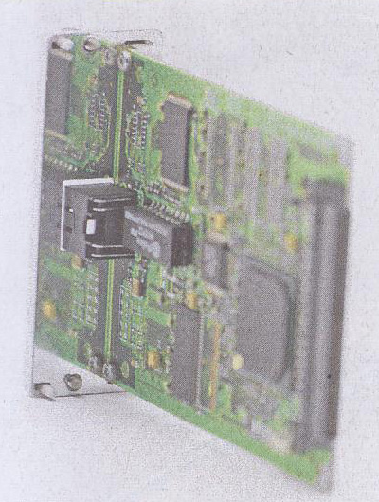

4. Integrated Circuit (IC) Chip
Vcc = 5v
Example of a 74LS00 chip: Quad NAND gates.
1
2
3
4
14
13
12
11
10
9
8
5
6
GND
7

Slide 20
5. Programming Logic Array (PLA) (1/3)
A programmable integrated circuit – implements sum-of-products circuits (allow multiple outputs).
2 stages
AND gates = product terms
OR gates = outputs
Connections between inputs and the planes can be ‘burned’.
Inputs
AND gates
Product terms
OR gates
Outputs

Slide 21
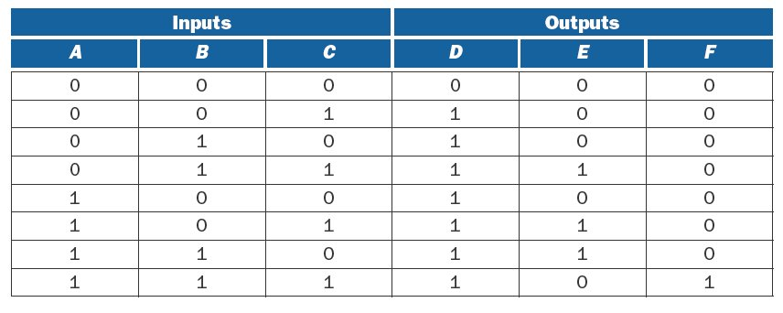
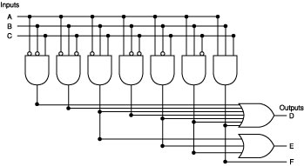
5. PLA Example (2/3)

Slide 22
5. Combinational Circuit Implementation
 | Opcode
 | Op5 | Op4 | Op3 | Op2 | Op1 | Op0
R-type | 0 | 0 | 0 | 0 | 0 | 0
lw | 1 | 0 | 0 | 0 | 1 | 1
sw | 1 | 0 | 1 | 0 | 1 | 1
beq | 0 | 0 | 0 | 1 | 0 | 0
Opcode
Control Signals

Slide 23
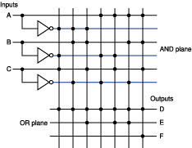
5. PLA Example (3/3)
Simplified representation of previous PLA.
Inputs
A
A
B
B
AND plane
C
C
A'⋅B'⋅C
A'⋅B⋅C'
Outputs
D
OR plane
E
F

Slide 24
6. Read Only Memory (ROM)
Similar to PLA
Set of inputs (called addresses)
Set of outputs
Programmable mapping between inputs and outputs
Fully decoded: able to implement any mapping.
In contrast, PLAs may not be able to implement a given mapping due to not having enough minterms.

Slide 25
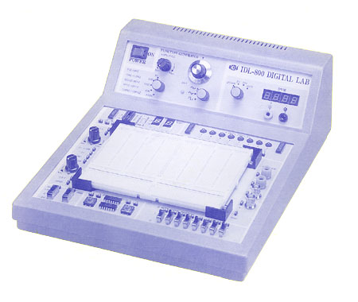
Lab Assignments (1/2)
For the next few labs, you will implement simple circuits using the Logic Trainer

Slide 26
Lab Assignments (2/2)
Lab sheets will be given out in lectures.
Remember to read the Logic Lab Guidelines before you come for your first lab session.
Please read the lab sheet and fill up as much as you can before the lab, or you may not have enough time to complete your lab experiment.
Aim to finish your experiment as quickly as possible. Vacate the room 10 minutes before the hour. If not, just submit your lab report.

Slide 27
End of File

